Slide 1
Exploring NoSQL at AGM
W205 - Section 8 - Project 3
Steven Chang, Chase Madson, Emanuel Mejia
Notes:
Thank you for joining our presentation today. Emanuel, Steven, and I are brand new to AGM’s data science team, as you know, and we are eager to share some of the data engineering know-how we’ve brought with us from our previous roles. Without further ado, let’s take a tour of NoSQL databases.

Slide 2

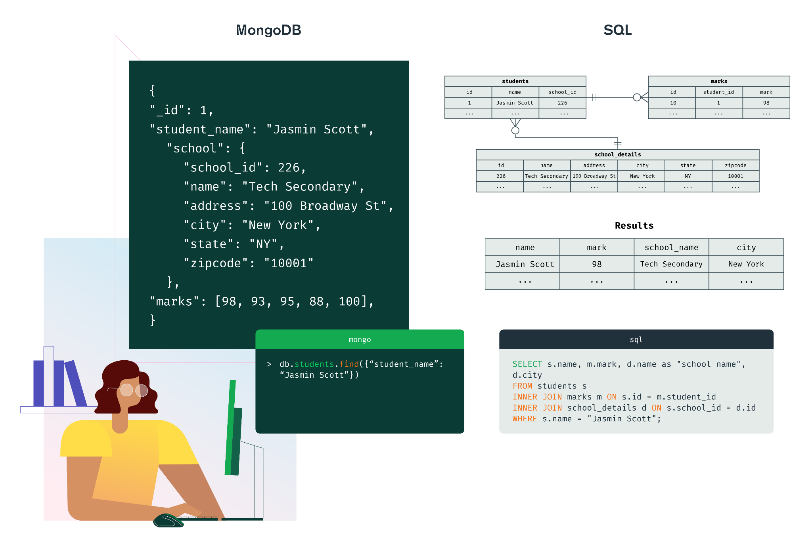
MongoDB
For storing collections of documents
Advantages
Represent many POVs
Fast
Tolerant schemas
Example
Perform geospatial lookups
Notes:
The first NoSQL database system to consider for improving how AGM uses its business data is MongoDB. This tool orients around what are called "documents" - think of documents as similar to JSON files that can be retrieved very fast by providing the key. Whereas SQL stores data in the rows of various tables, in MongoDB data is stored in documents of various collections.
[NEXT] Why use this method to store data over relational databases? Depending on the scenario MongoDB may be the preferable choice:
Good for Analytics over Many POVs: At AGM we may want to look at our data from the perspective of the stores, of the different products, of the customers, and so forth. With MongoDB we can design different collections of documents for analytics to represent these different POVs. We can even automate complex computations, store them in our collections, set a periodic refresh rate, and then that information will be available on demand. That brings me to the next point…
Speed: MongoDB performs better when working with simple queries. The data in these documents are refreshed periodically, and so you're not carrying out a complex SQL join like you see on the right but rather you're just providing a key and getting the document back. Simple!
No Fixed Schema: MongoDB lets each document be flexible in shape and format - some customers will have a variable number of contact emails or phone numbers that a relational database would be less efficient for storage. SQL requires strict schemas before allowing you to enter fields onto it, while in MongoDB each document can have its own distinct field.
[NEXT] An example of MongoDB for AGM that’s in line with our executive's visions is this. Let's say we're considering adding more pickup locations. We can take advantage of MongoDB's geospatial lookup features by pulling all customers living within range of each stop and using it to decide things like hours of operation, whether there's enough customers to justify the location, or whether the customer base has outgrown the pickup point.
So that’s document databases using MongoDB. I’ll hand it over to Emanuel to tell us about Redis.

Slide 3
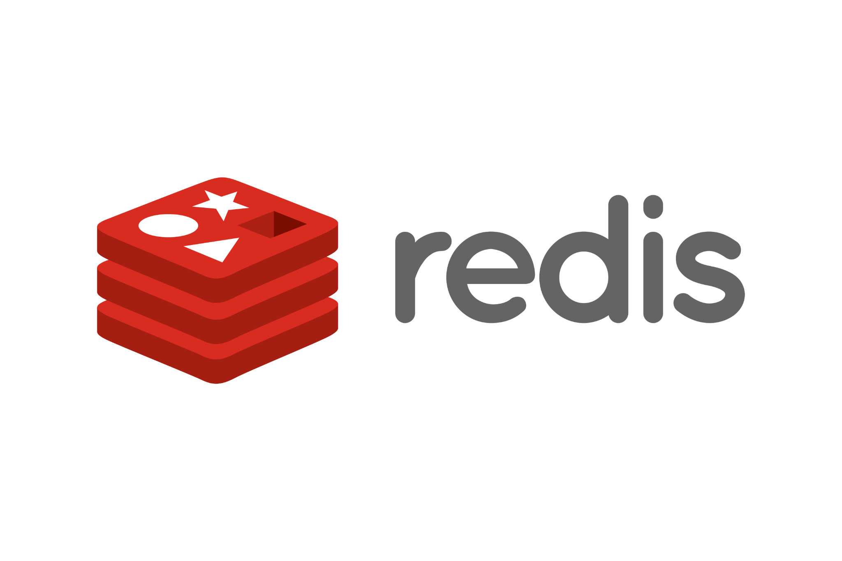
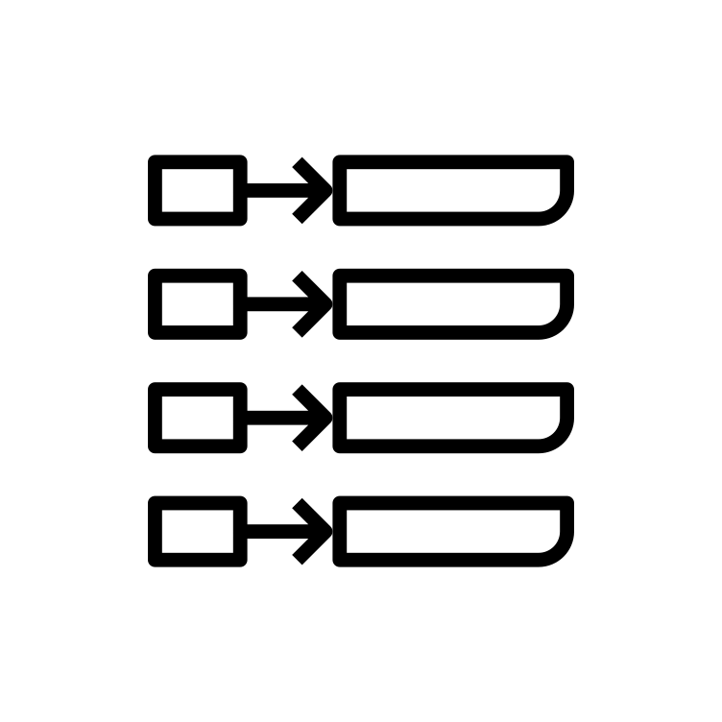
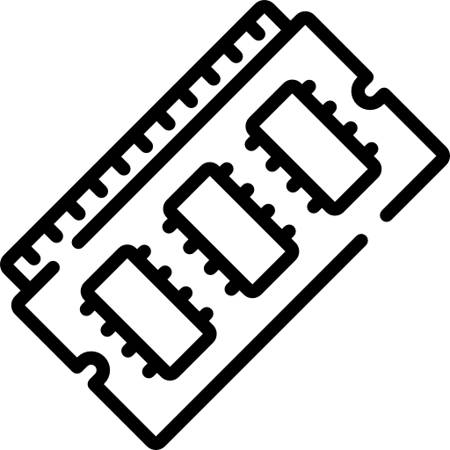

REmote DIctionary Service
Key - Value
In-Memory
Database-Server
Examples:
Real-time inventory system
Real-time shipping information
Notes:
Redis stands for Remote Dictionary Service NEXT
It is defined as a key-value In-Memory database server. NEXT
It is structured in key-value pairs. Same logic as the python dictionary. Keys must be unique but values could be text, JSON or binary objects (data, pictures, audio, video, etc…). NEXT
The second part means that data is stored in memory (instead of any storage device) so it leverages the speed of memory and it becomes extremely fast when querying by key. NEXT
As a database server… at this point Redis is primarily used as a cache in front of another usual relational database (PostgreSQL or MySQL), but for many applications Redis guarantees that it can be used as a primary database because they have worked hard to alleviate one of the major downsides of storing data in memory: potentially losing it when memory goes off.
There are many cases where redis can deploy exceptionally, but for the specific scenario of Acme Gourmet Meals we could mention two. NEXT
We could use a real-time inventory system because customers will expect having accurate information when placing an order and not having delays or missing items.
We could also consider giving customers real-time shipping and tracking information which should be fast to update and to consult, since they will be expecting their meal at a pick-up center or at home in a matter of minutes.
In both cases we need faster information than the one you can retrieve from a relational database. Especially if we deal with a spike in demand (as we would expect with our business proposal). Delayed or inaccurate information may lead to shopping cart abandonment and order cancellations (with their respective lost revenues and brand damage) END

Slide 4

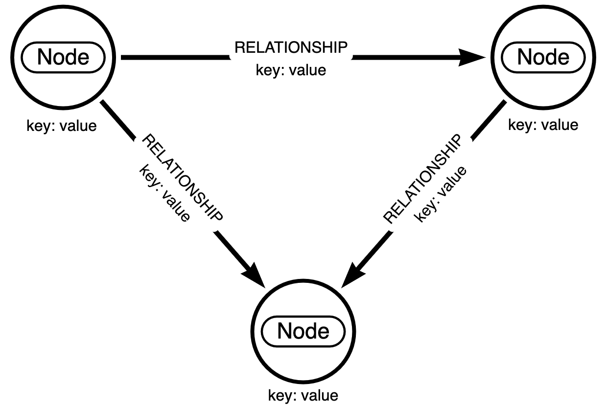
Neo4j
Examples:
Internal Supply Distribution
Efficient and Flexible Delivery Service
Notes:
Neo4j is a popular Graph Database designed for mapping complex relationships where data is stored as nodes and relationships between these nodes. A node represents an entity and relationships represents the connections between those entities. Nodes can be labeled differently, and nodes and relationships can have properties as key/value pairs, providing more information about them. To put this in terms of relational databases, nodes are the rows and relationships are the foreign keys.
Because data is stored as nodes and relationships, graph databases are great at mapping complex relationships, in particular in situations where multiple JOIN operations would be required in a relational database. As such it is commonly used for exploring networks.
It is also flexible and easy to scale horizontally, as new nodes, relationships, or properties can be easily added without modifying other parts of the database. There is no required schema for each node/relationship type.
NEXT
An example of using a graph database is Internal Supply Distribution, where each node is a possible supplier and relationships are materials, transportation links, travel times, or costs of transportation. Add in other nodes such as distribution centers, retail stores, etc, and we have a mapped out system of internal distribution, where we can explore critical weak points, alternate routes and solutions in case of delays and emergencies. All of this using built in algorithms in the Neo4j system.
Another example would be in providing our own delivery service. We can list all of our servicing areas and store locations in the database, and combine it with a graph of local public transit. This will let us more easily find the fastest route for delivery from our stores and find communities that can be serviced together. If we wish to explore other modes of transportation, we can easily expand our database, allowing us to explore hybrid models as well. We can also use built in algorithms to determine optimal routes and communities for easier delivery, which we will be showing later in this presentation.

Slide 5
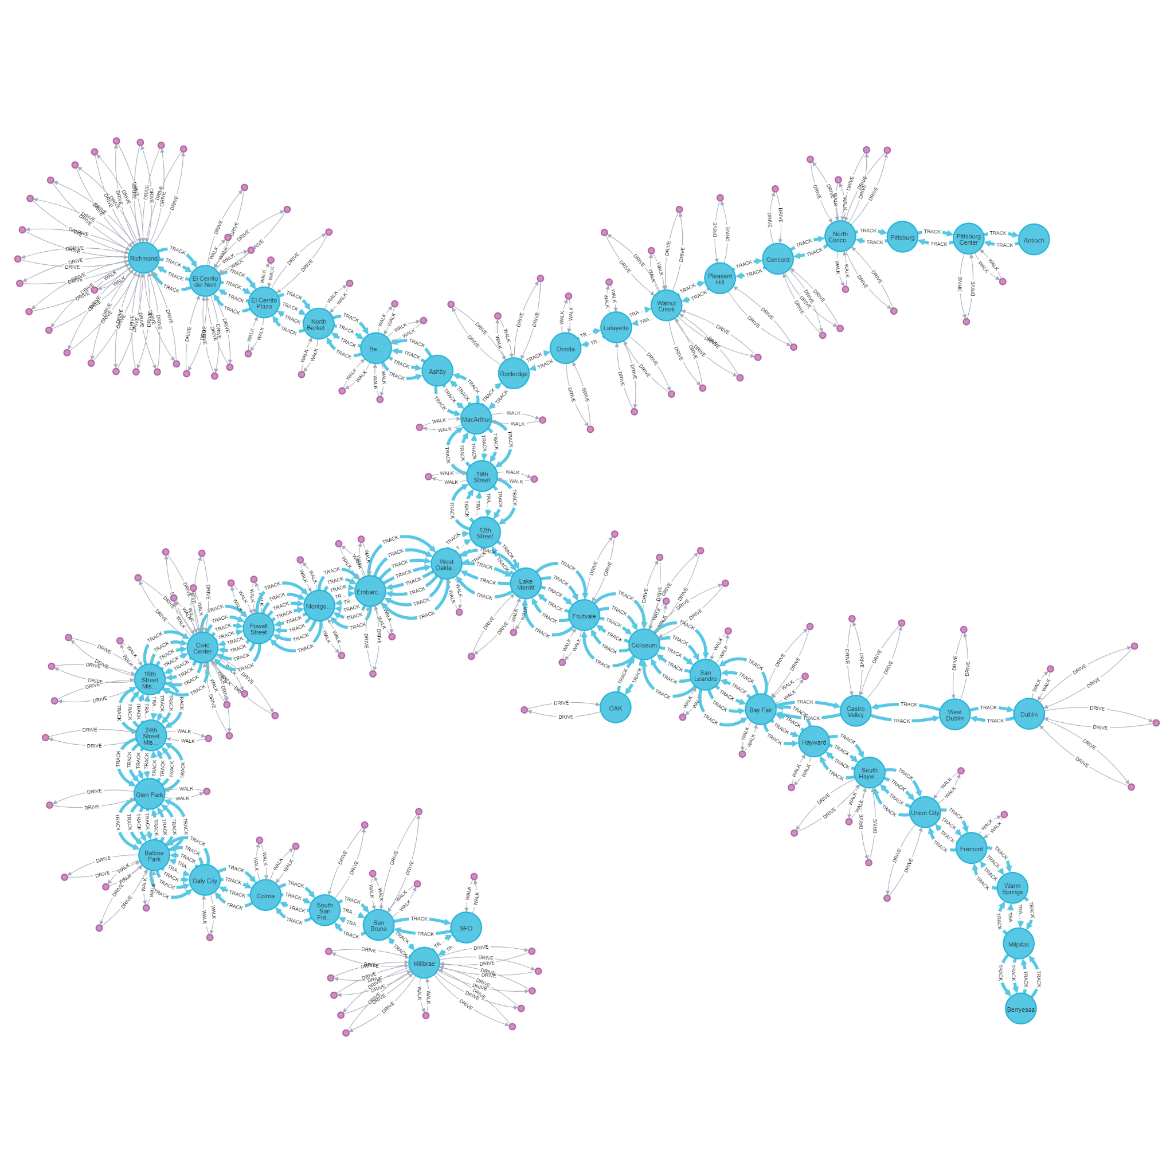


Graph Database
Consider our network:
Which stations do we
want to open delivery
locations at?
Notes:
That was just a cursory introduction to a few of the NoSQL technologies this data science team should consider adding to its tool kit. Now let’s dive deeper into what Steven was covering and look at the use case for Neo4j graph databases here at AGM with a proof of concept.
At the recent AGM executive meeting, leadership rolled out their vision for the future of the company that involves strategically adding pickup locations at select BART stations as a delivery endpoint for customers, as well as third-party delivery services. Clearly, it won’t be feasible to staff and service a pickup location at each of the 50-something BART stations, so we are going to need to make some decisions on what the best stops are.
In selecting these locations, we want to make sure there is sufficient coverage in each regional cohort of our customer base across the Bay Area.
[NEXT] This is exactly the kind of problem that Neo4j was created for, allowing us to collate BART locations with our customer network to determine optimal placement of pickup locations.
[NEXT] Shown here is the graph network we created to show the network of BART stations. Each of the connections between our nodes stores information about distance and travel time.
[NEXT] We next included nodes representing all Bay Area ZIP codes where AGM customers reside, connecting them each to their closest BART station. We set a distance cutoff to differentiate ZIP codes that are outside of walking distance.
[NEXT] Finally, we trimmed our network down to focus on the ZIP codes reasonably close to a station.
[NEXT] We considered all 3 of these variations of our network graph and performed a few data science algorithms that help answer our business question: which stations do we want to open delivery locations at?

Slide 6
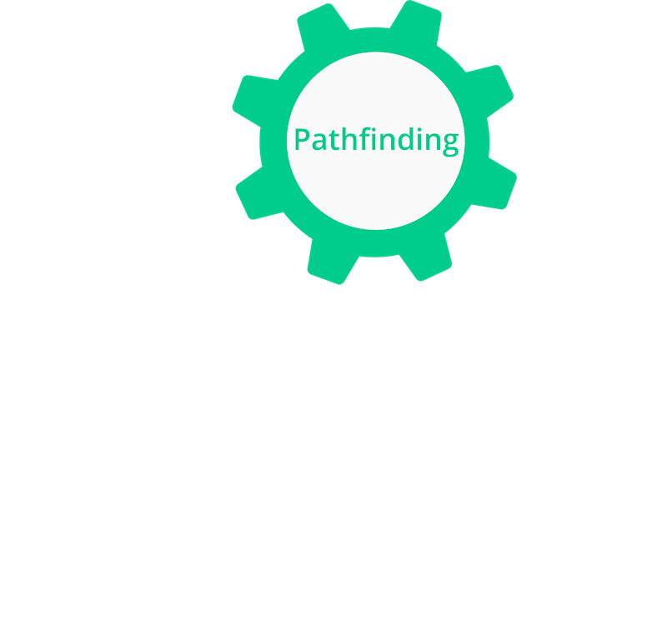


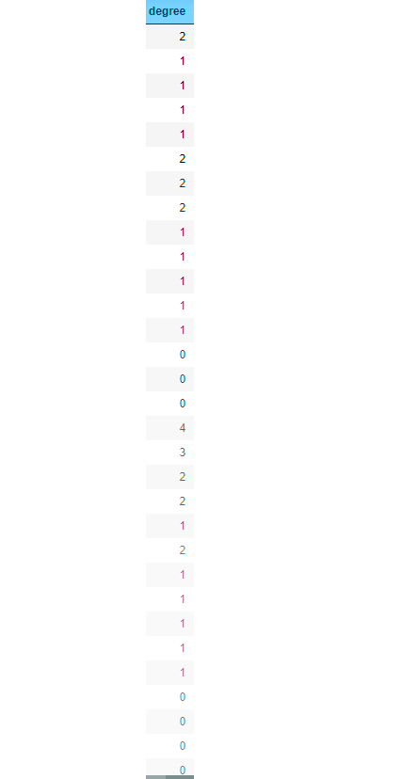
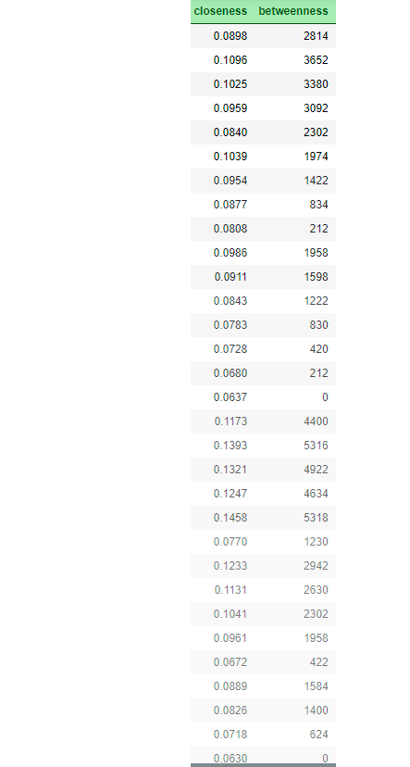
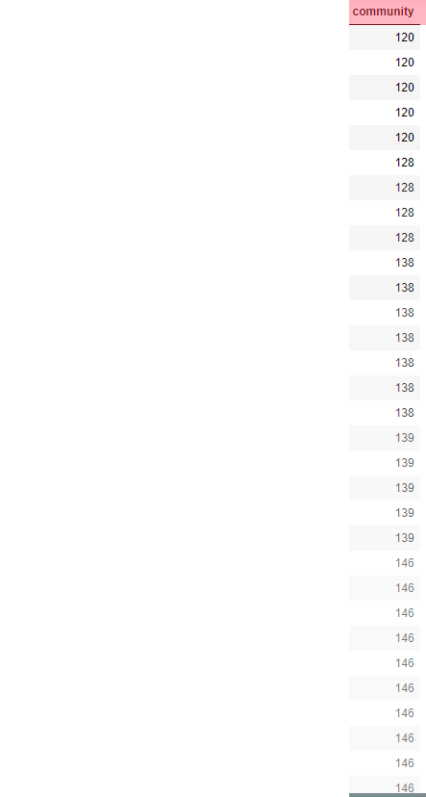
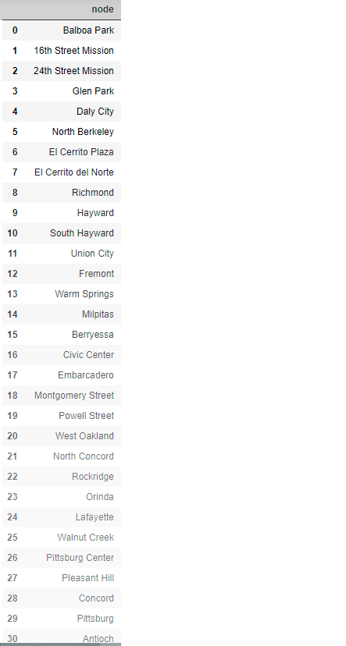
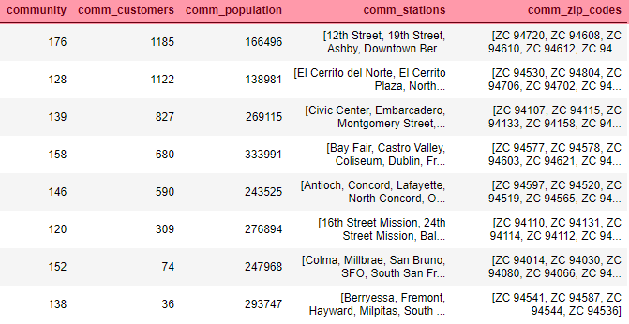
Algorithms
Notes:
We ran different graph algorithms in order to answer this question. NEXT
To summarize this we elaborated what we call a graphy features table which needs us to obtain all the station nodes. NEXT
We start by running a “Degree Centrality” algorithm which usually represents the number of relationships a node has both incoming and outgoing. In our case it represents only the close zip codes relationships, meaning the number of close zip codes for which the closest station is the one we’re analyzing. NEXT
Then we run two more centrality algorithms which also use path algorithms, specifically to find the shortest path between two nodes.
The first one’s named “Closeness Centrality” which is a measure of the average shortest distance from a node to every other node. Actually, it is the inverse of that average and a high closeness means shorter distances to other nodes, so they may be able to spread information more efficiently.
The second one is Betweenness Centrality which calculates how many shortest paths pass through each node; high betweenness could represent control point, which means that the node may have high influence over the flow within the graph NEXT
And finally we run a community detection algorithm named Louvain Modularity - which creates groups of nodes by maximizing a modularity score for each community or group, where the modularity quantifies the quality of an assignment of nodes to communities, or basically how well a node is assigned to a group, by evaluating how much more densely connected the nodes are, compared to how connected they would be in a random network. NEXT
After finishing our table and detecting our groups we also determined which station and close zip code nodes belong to each community, as well as the total consumers and total population for that group of nodes END

Slide 7
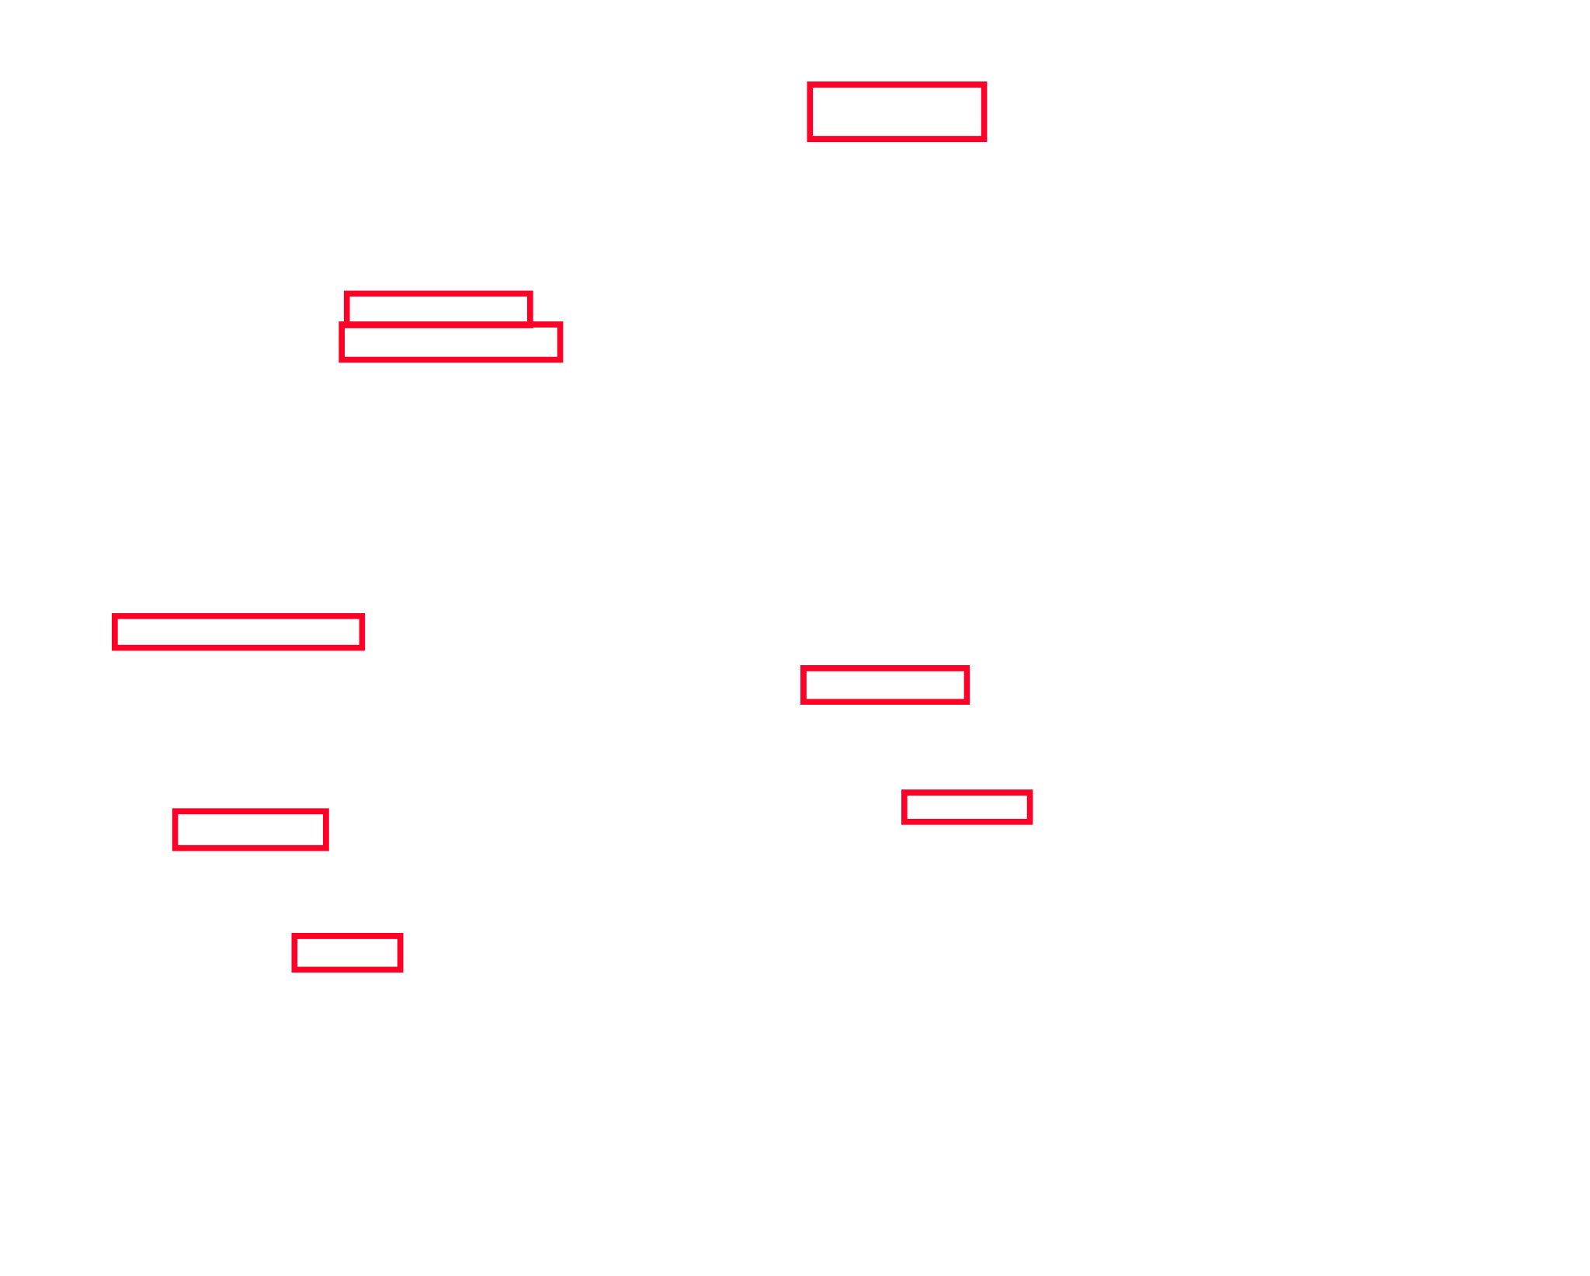
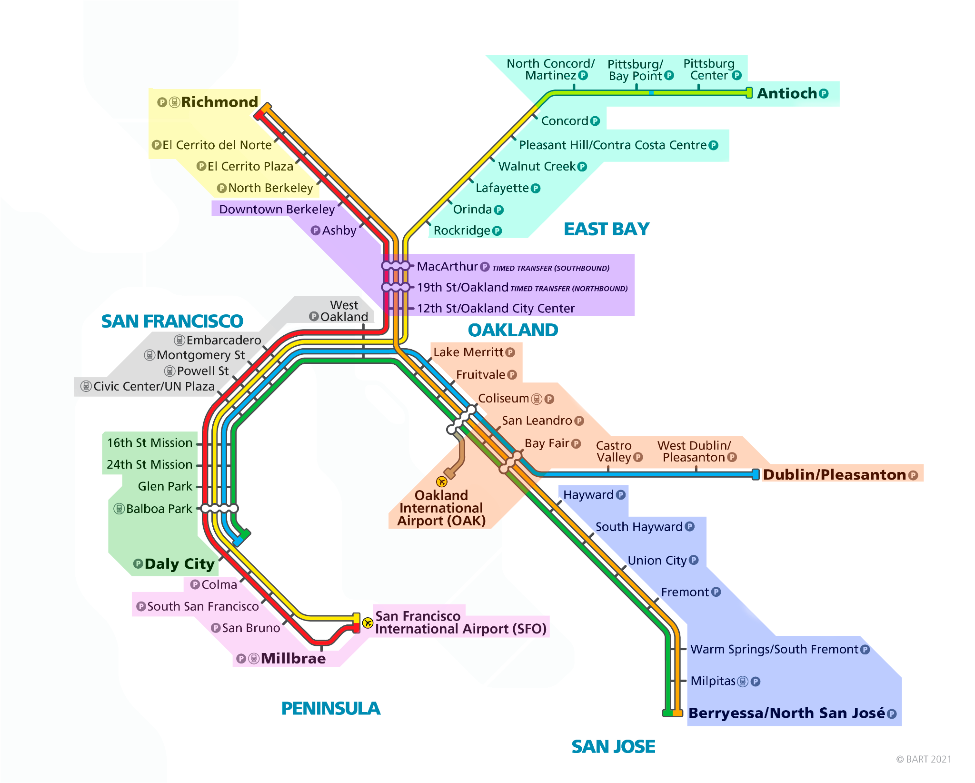

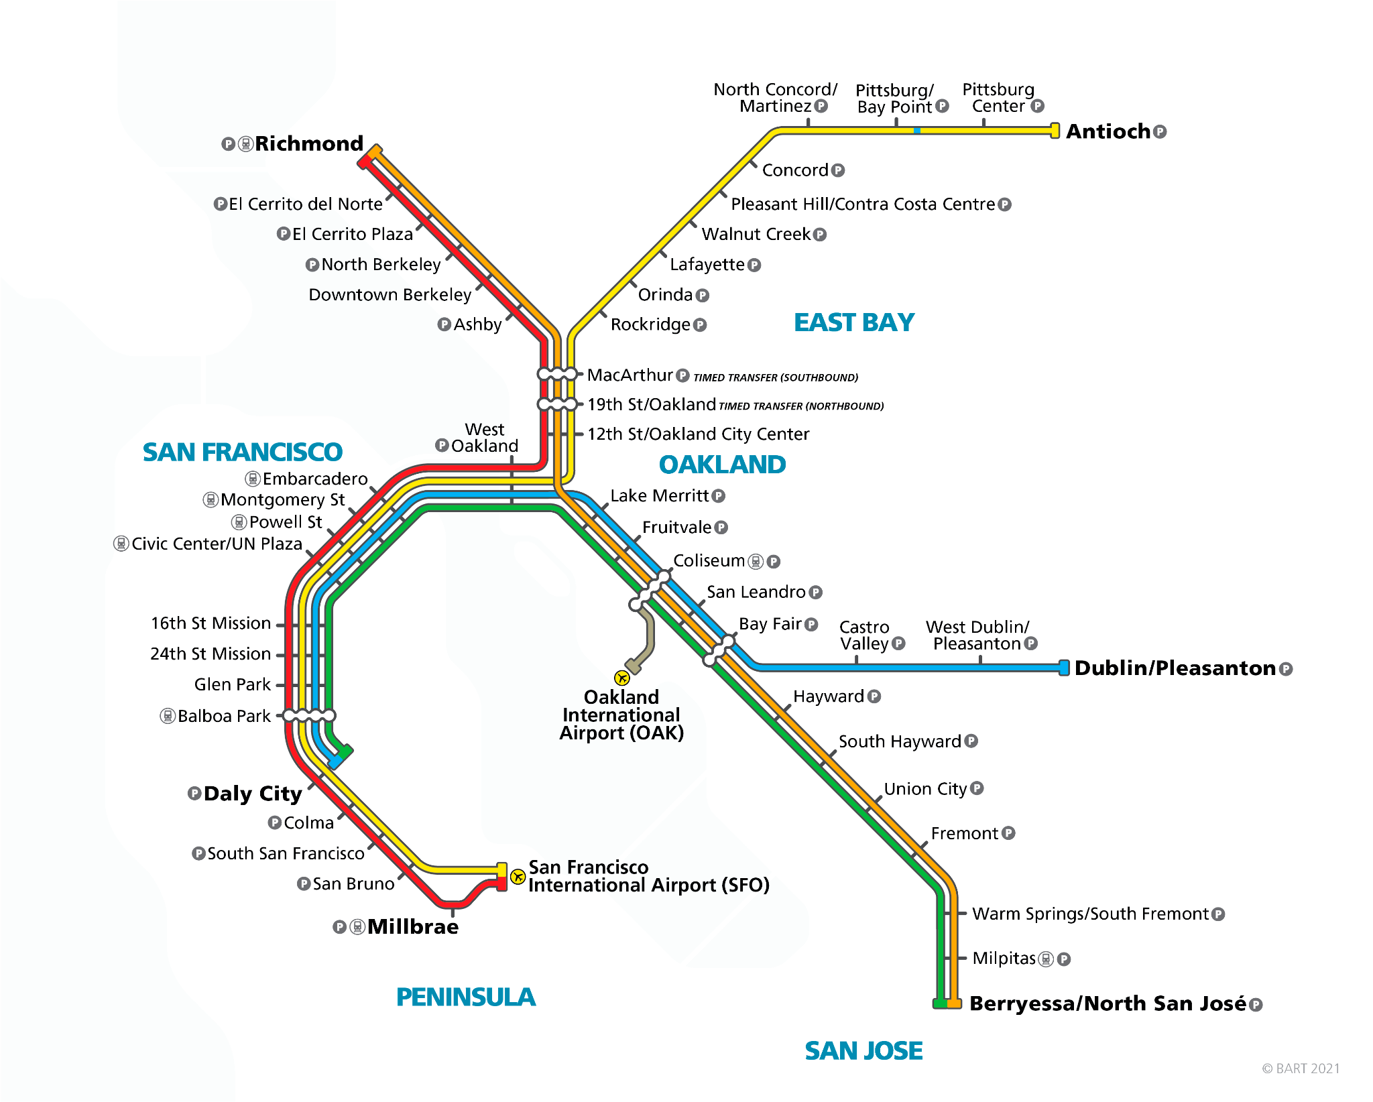
Results
Notes:
Here you can see a map of the BART system. NEXT
We’ve found 8 communities when taking close zip codes into consideration. This was done using the aforementioned community detection algorithm.
NEXT
By using our centrality algorithms we’ve found the most impactful stations per community. These are the primary stations that are most centrally located and would be best to use as a single point of delivery for the community.
NEXT
Taking other variables into account (such as existing customers in the community), we decided to open a pick-up station just in 5 of them, which you can see highlighted in red.
Colma and Hayward are in communities with less than 100 customers in them and they could be part of a second phase after we test the first selected stations.
We decided to leave out Downtown Berkeley since the store is about 1 mile away from it. The North Berkeley station, which is also nearby, could be left out, but we believe it will help to act as a central point in that branch of the line.

Slide 8
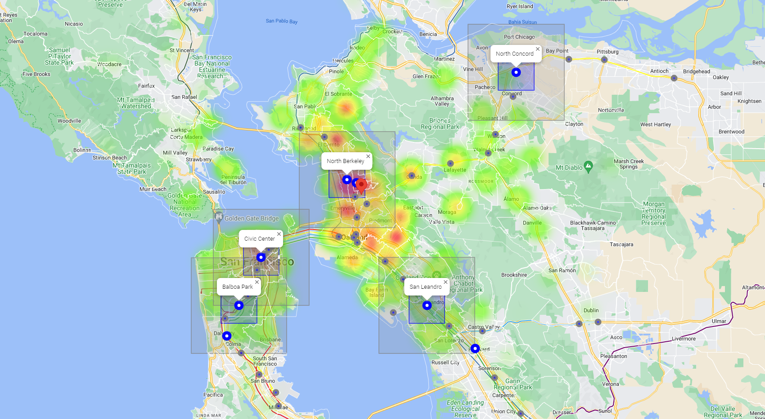
Results
Notes:
EM Map explanation:
Gray round markers: BART stations
Red marker in the middle: ACME store location
Big blue round markers: Stations selected for each community (8 stations)
Blue square: “Walking distance” 1.5 mile square around the final selected pickup stations (5 stations)
Gray square: “Drone or truck” 4-mile-square around the final selected pickup stations (5 stations)
Heatmap: Shows customers per zip code
In fact, you can see how close these stations are geographically in this google map. Here we have each station marked out in gray, the primary stations marked in blue, and the Berkeley store as the red pin.
The blue square around each station is a 1.5 mile square, more or less representing walking distance away from the station. The gray square is a 4-mile square that we can consider for possible driving or drone delivery from the station. The heatmap is of the amount of existing customers in each zipcode.
Once again, you can see how close the Berkeley station is to the store, so we decided that the store itself will be able to service that community around Oakland.

Slide 9
Questions?
Notes:
We’ll go ahead and leave things there.
We hope we’ve left you with a good understanding of some of the database tools that go beyond SQL, and at this time we are happy to take any questions.

